Slide 1
ENSE 374, MILESTONE 2
UR XTECH
JULIO A. SILVA, KADEN GOSKI, PAUL WANGWE
OCTOBER 23RD, 2019

Slide 2
PROJECT BLURB & MVC ARCHITECTURE
“MovieNow”, Simple and Clean interface that allows users to view trailers, rate movies and sort them based off of ratings.
Our envisioned MVC architecture will be shown/described in the Lo-Fi prototype sketches.

Slide 3
DOMAIN DRIVEN DESIGN, UMLING, & MVP-1
Illustrate/display and discuss any UML diagrams your team has created for your MVP-1
  NOTE: You don’t have to use all diagrams we discussed – pick ones you like using keeping in mind topics discussed in class, i.e. class diagrams should be last…recall why?? ☺).
  Collaboration
  Data
  Class
  Etc.
Associate your diagrams with how you are applying domain driven design to solve your problem

Slide 4
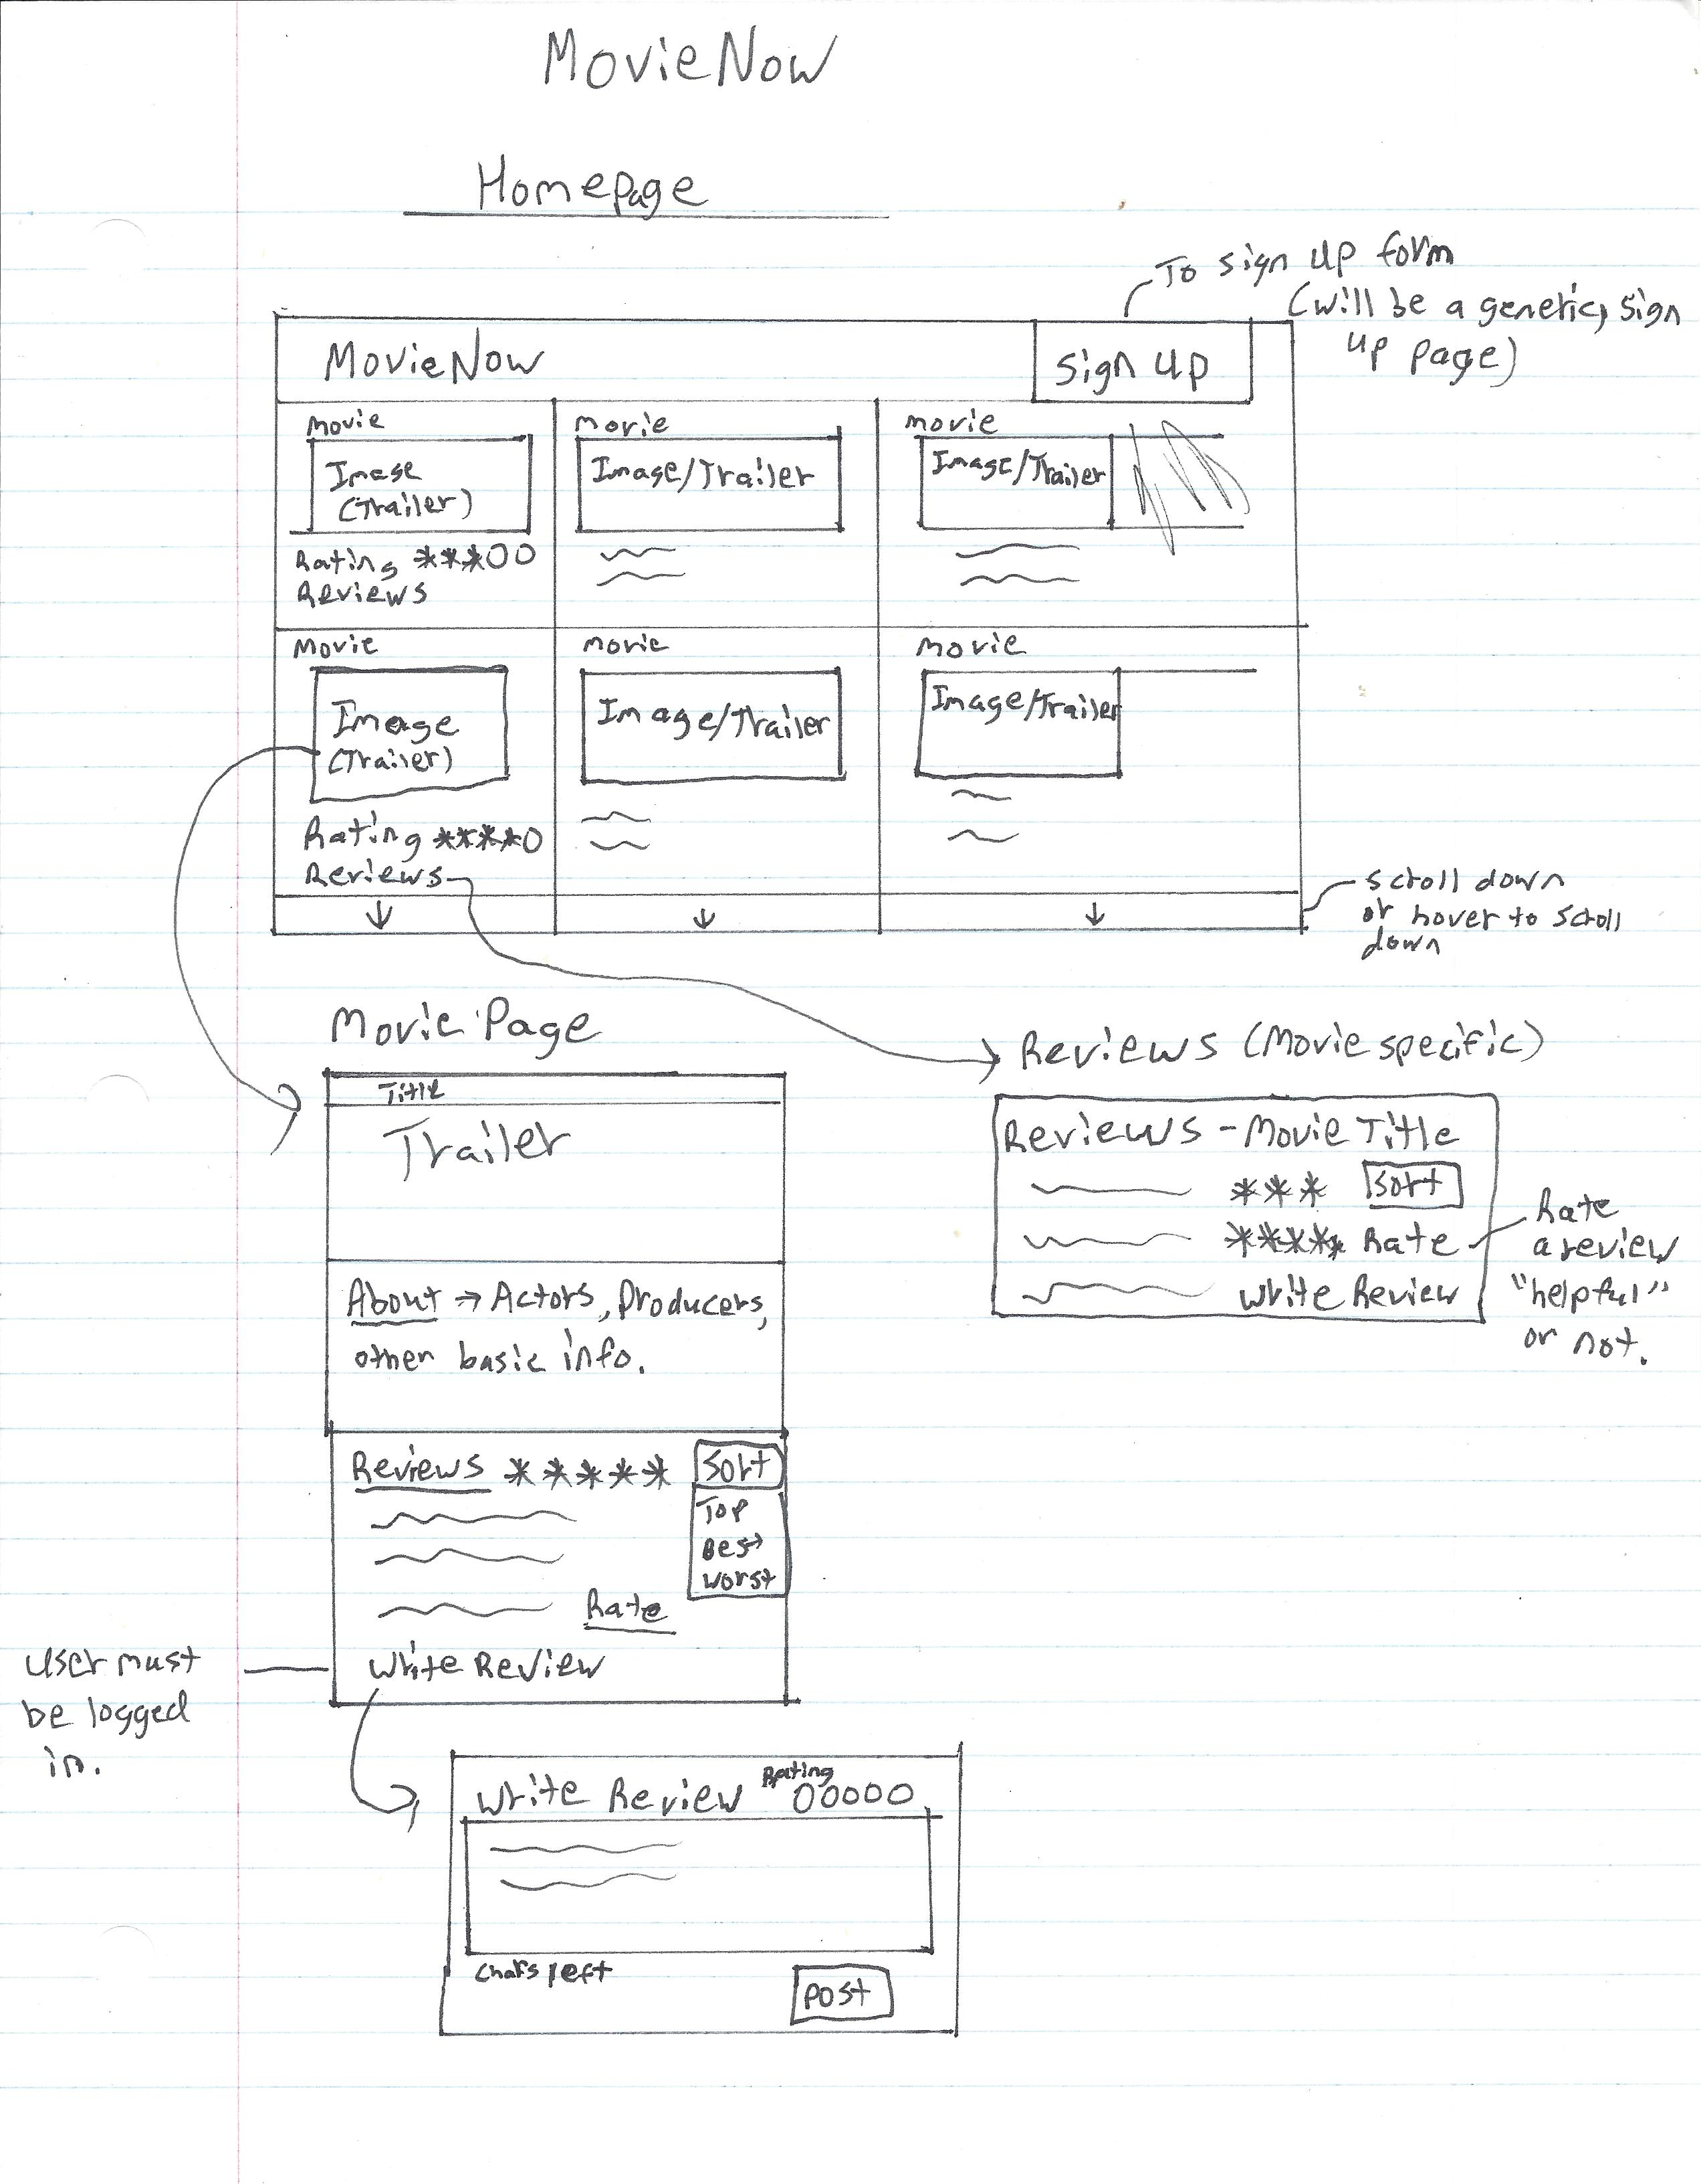
LO-FIDELITY PROTOTYPE

Slide 5
REQUIREMENTS, KANBAN & GITHUB REVIEW
Illustrate, quickly go over, your team’s evolved requirements document
Any other changes in your project from your team’s last presentation?
Illustrate your updated Kanban (in GitHub)
  Describe any addition/change/movement of user stories
  What is your team’s focus for MVP-1?
    Are there envisioned barriers (I don’t want to hear “time” – I get it, we busy)
Review your team’s GitHub
  Describe the files structure and file “up-to-dateness”
  Provide team’s “stamp of approval” that it is up to date

Slide 6
MISC.
Add other insights if you like but remember, your group’s report-out must be kept within 5 minutes

Slide 7
GROUP REFLECTION
How did you feel about this milestone? What did you like about it? What did you dislike?
  We felt that this milestone was another great step forward to get prepared for beginning to code and program the application.
What did you learn about yourself as you collaborated and worked through this milestone?
  We learned that we all have different skillsets and preferences. For example, no one is good at/ likes drawing and so the Lo-Fi sketches were a toss up on who would do them.
How will you use what you have learned going forward?
  Going forward, our first step to handing out tasks will be to consider skillsets and if no one is good at a particular task. Ensure that these tasks are given out evenly.
What “stuff & things” related to this milestone would you want help with?
  Nothing in particular.

